Slide 1
SkyGAN: Unsupervised Representation Learning of Weak Structured Images
Yuanhang Ma & Tao Cheng

Slide 2
Motivation
“The most important one, in my opinion, is adversarial training (also called GAN for Generative Adversarial Networks)…the most interesting idea in the last 10 years in ML” -- Yann LeCun
Excellent test of our ability to use high-dimensional and complicated probability distributions.
Realistic generation tasks
We have achieved great success in structured images like numbers, faces. So how about weak structured images like cloud?
Ian J. Goodfellow & Yoshua Bengio.(2014).Generative Adversarial Nets
Alec Radford & Luke Metz .(2016).Unsupervised Representation Learning with Deep Convolutional Generative Adversarial Networks
Notes:
Original GAN is proposed by Goodfellow in 2014.
realistic generation tasks like city scene generation.

Slide 3
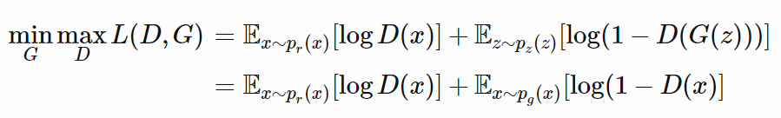

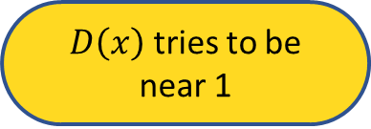
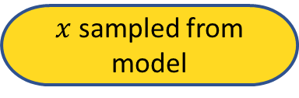
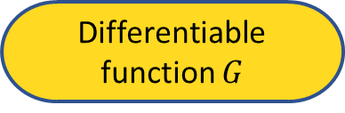

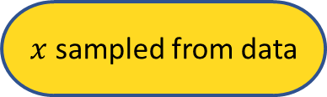
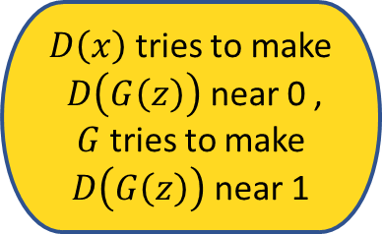
Adversarial Nets Framework
$D\left(x\right)$tries to make $D\left(G\left(z\right)\right)$ near 0 , $G$ tries to make $D\left(G\left(z\right)\right)$ near 1
$D\left(x\right)$ tries to be near 1
$$D$$
Differentiable function D
$x$ sampled from model
$x$ sampled from data
Differentiable function $G$
Input noise $z$
Ian Goodfellow. NIPS 2016 Tutorial: Generative Adversarial Networks
Notes:
one is generator, one is discriminator or critic

Slide 4
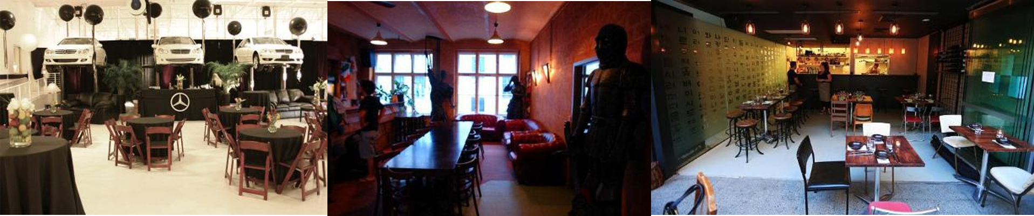
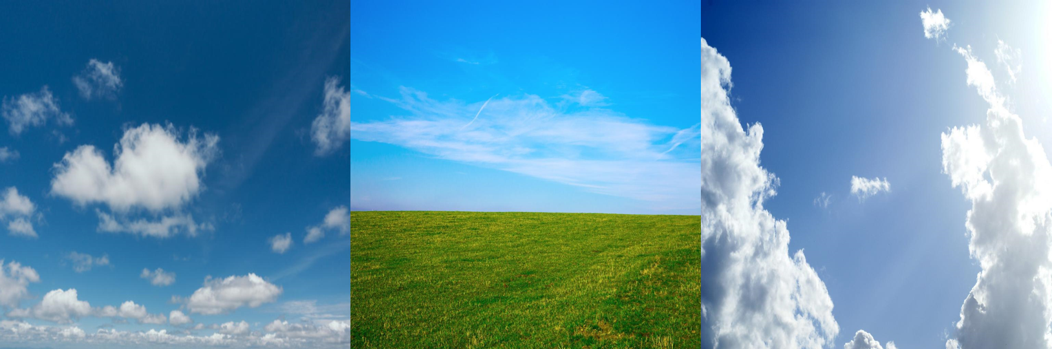
Dataset
LSUN dataset (10k)
Sky images from the Internet (1k)
Fisher Yu, Ari Seff.(2015).LSUN: Construction of a Large-scale Image Dataset using Deep Learning with Humans in the Loop
Notes:
These sky images are crawled from the Internet.
LSUN have 10 scene categories, 20 object categories

Slide 5
Model
DCGAN
Replace any pooling layers with strided convolutions (discriminator) and fractional-strided convolutions (generator).
Use batchnorm in both the generator and the discriminator.
Remove fully connected hidden layers for deeper architectures.
Use ReLU activation in generator for all layers except for the output, which uses Tanh.
Use LeakyReLU activation in the discriminator for all layers.
Alec Radford & Luke Metz .(2016).Unsupervised Representation Learning with Deep Convolutional Generative Adversarial Networks
Notes:
This paper proposed lists of techniques to make training more robust.
Pooling: max pooling, average pooling, is a under sampling method.
Strided convolutions means kernel remove with >=1 stride
Directly applying batchnorm to all layers
however, resulted in sample oscillation and model instability.
A fractionally-strided convolution (deconvolution) a.k.a transposed convolution
Batch normalization is a technique that make sure the input of network layer is normalized, i.e (x-u)/sigma
LeakyRelu like this
Tanh is from -1 to 1
DCGAN is class of CNNs called deep convolutional generative
adversarial networks (DCGANs), that have certain architectural constraints.

Slide 6
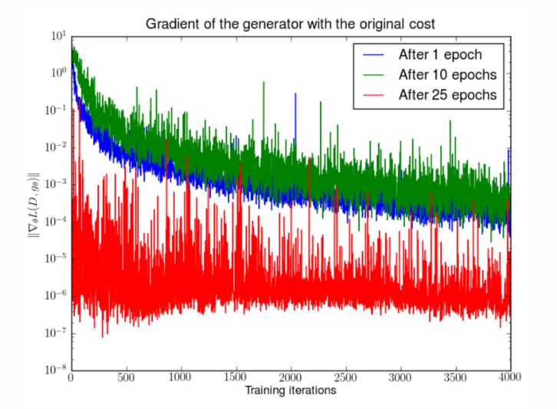
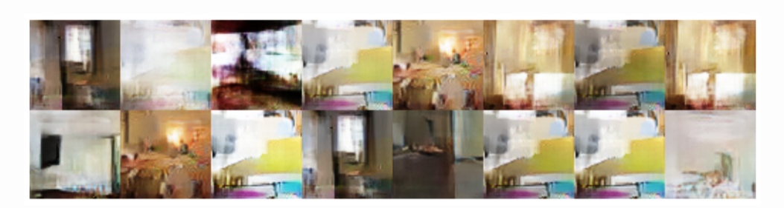
Model
Wasserstein GAN(the glory of Math!)
problems in previous GAN model:
mode collision, vanishing gradient
Arjovsky, Soumith Chintala.(2017). Wasserstein GAN
Martin Arjovsky .(2017).Towards Principled Methods For Training Generative Adversarial Networks
Notes:
The deepest reason of problems in previous GAN model the loss of Discriminator means nothing.
Don’t push generator generate various sample
Push generator generate bad sample.
WGAN前作Figure 2。先分别将DCGAN训练1，20，25个epoch，然后固定生成器不动，判别器重新随机初始化从头开始训练，对于第一种形式的生成器loss产生的梯度可以打印出其尺度的变化曲线，可以看到随着判别器的训练，生成器的梯度均迅速衰减。注意y轴是对数坐标轴。

Slide 7
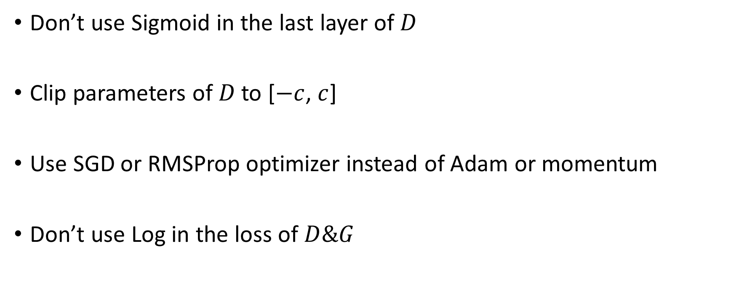
Wasserstein GAN(the glory of Math!)
Don’t use Sigmoid in the last layer of$D$
Clip parameters of$D$ to [$−c$, $c$]
Use SGD or RMSProp optimizer instead of Adam or momentum
Don’t use Log in the loss of$D\&G$
1. Arjovsky, Soumith Chintala,.(2017). Wasserstein GAN
Notes:
但是现在WGAN中的判别器[公式]做的是近似拟合Wasserstein距离，属于回归任务，所以要把最后一层的sigmoid拿掉

Slide 8
Wasserstein GAN(the glory of Math!)
1. improve the stability of learning
2. get rid of problems like mode collapse
3. provide meaningful learning curves useful for debugging and hyperparameter searches.
1. Arjovsky, Soumith Chintala,.(2017). Wasserstein GAN

Slide 9
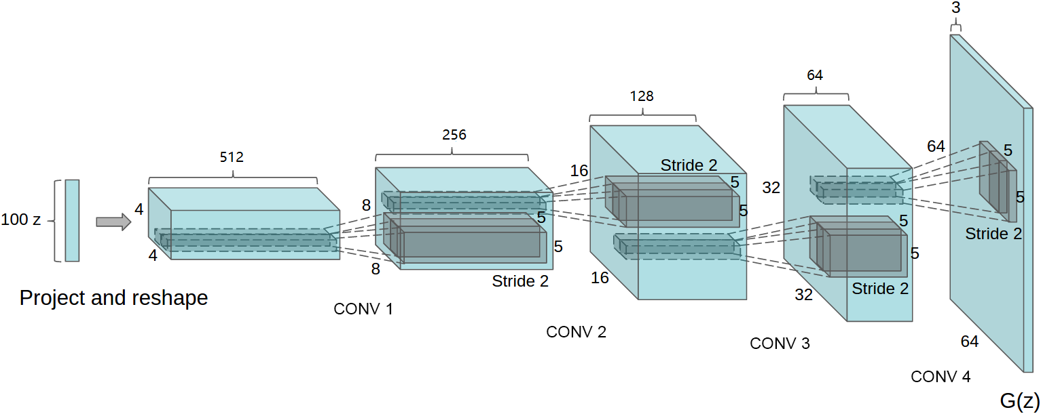
Model Architecture
Generator

Slide 10
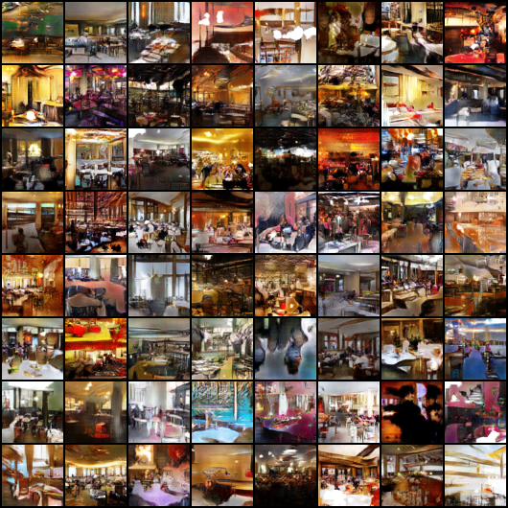
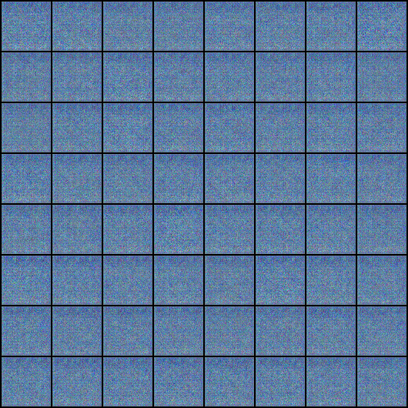
Experiments & Results(LSUN)
25 training epochs

Slide 11
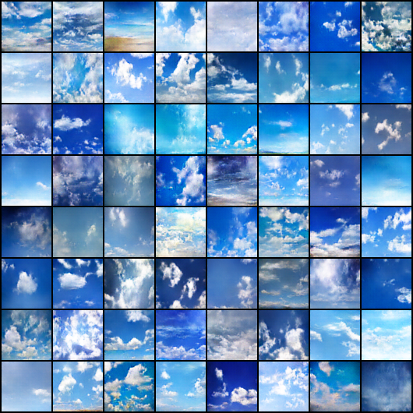
Experiments & Results(Sky Images)
200 training epochs

Slide 12
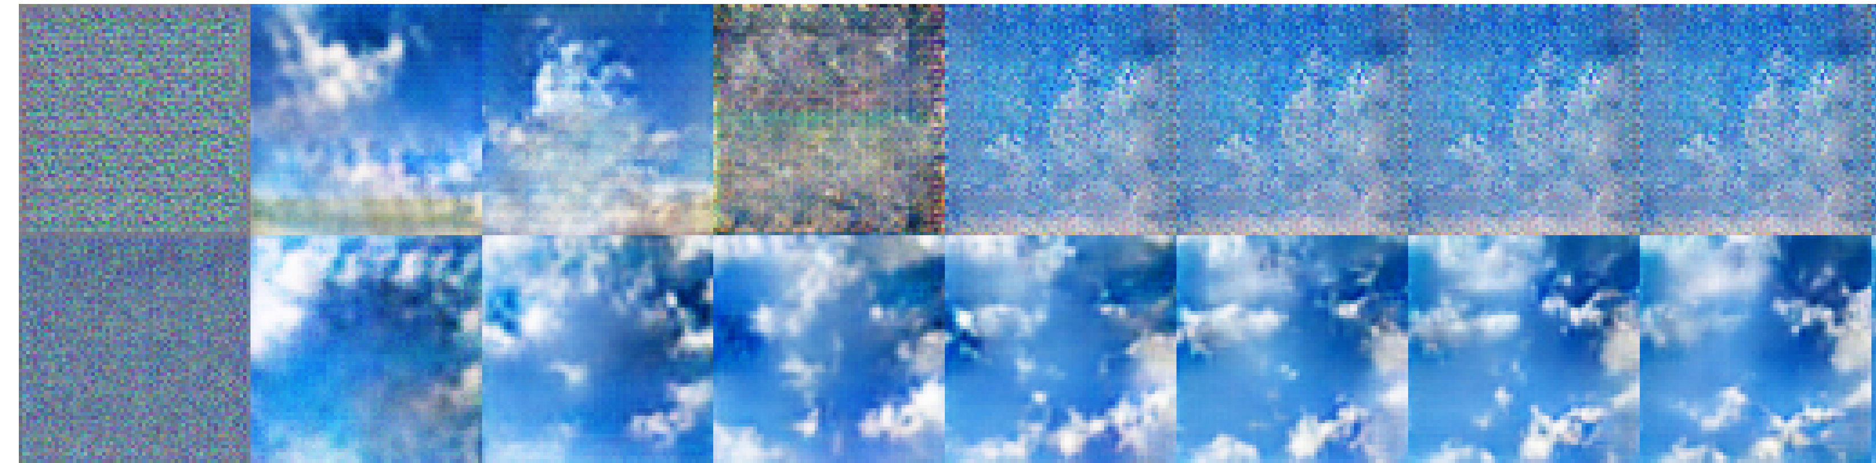
DCGAN vs WGAN
Stability
DCGAN
WGAN
0
200
400
600
800
1000
1200
1400
epoch
Notes:
The problem of gradient vanishing and mode collision.

Slide 13
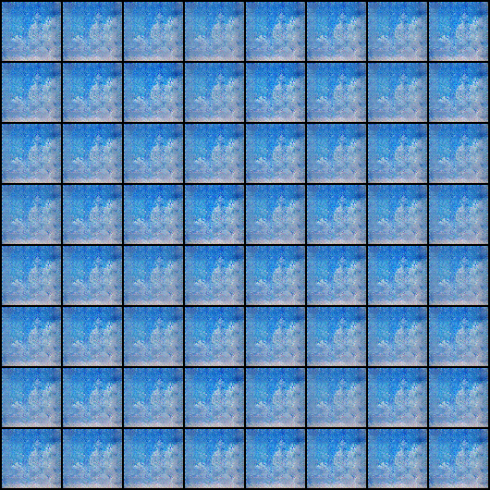
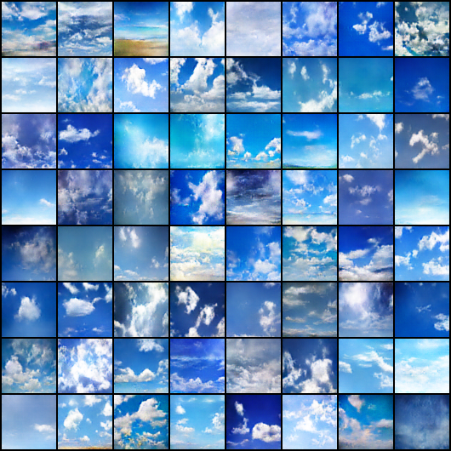
DCGAN vs WGAN
Variety
DCGAN
WGAN
After 1900 epochs

Slide 14
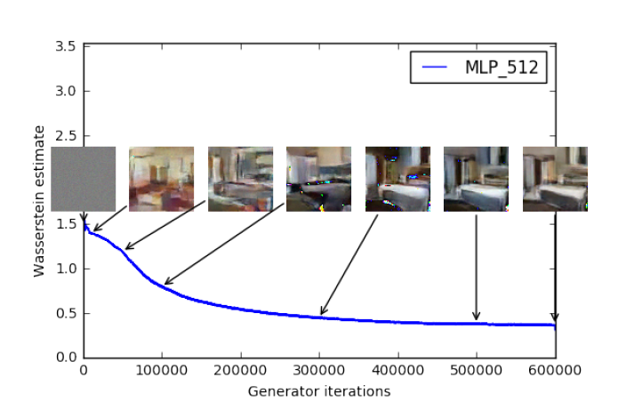
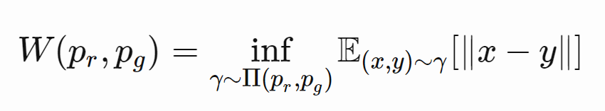
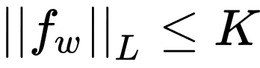
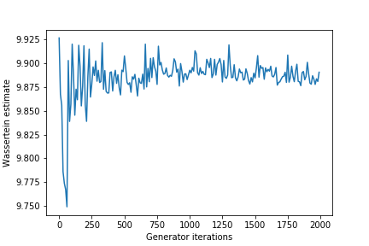
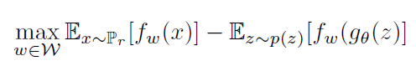
Wasserstein Distance (Earth Mover’s distance)
Under the constraint
Notes:
注意原始GAN的判别器做的是真假二分类任务，所以最后一层是sigmoid，但是现在WGAN中的判别器[公式]做的是近似拟合Wasserstein距离，属于回归任务，所以要把最后一层的sigmoid拿掉。 Lipschitz常数

Slide 15
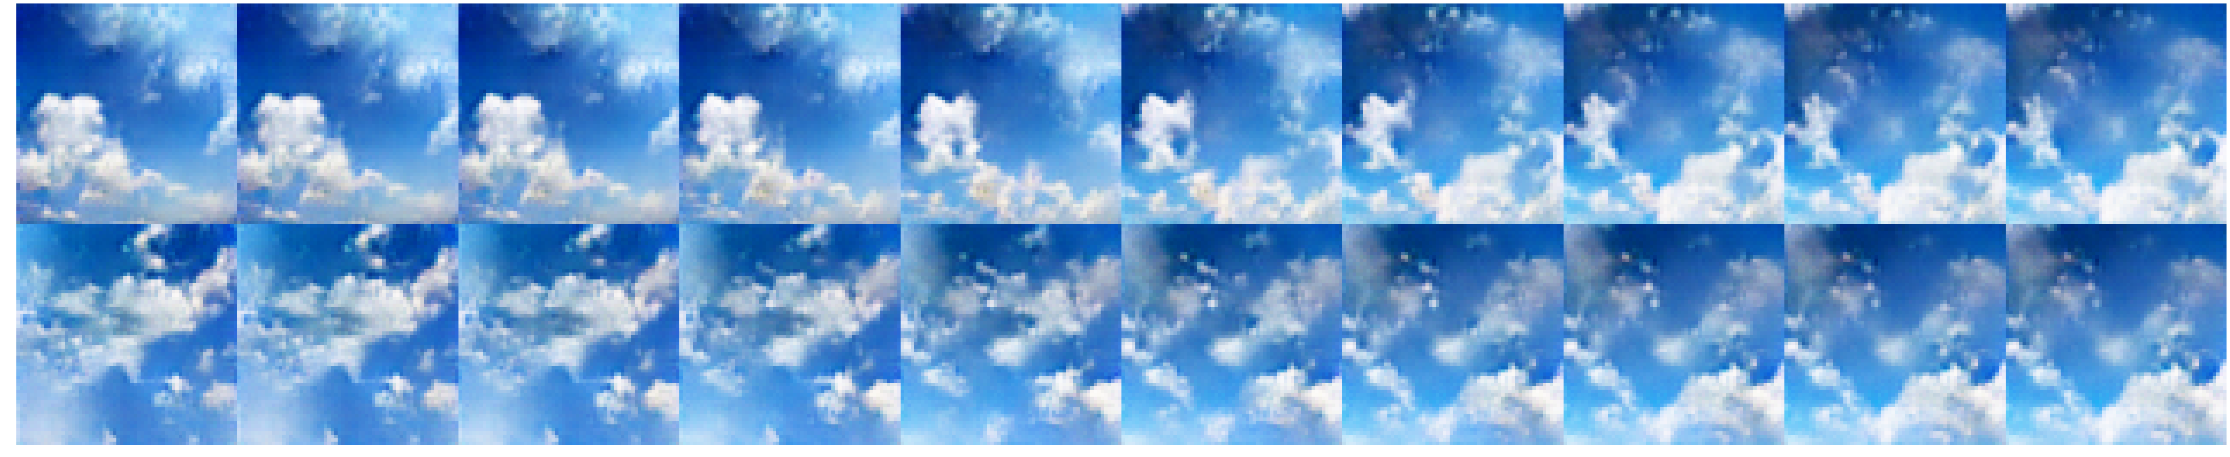
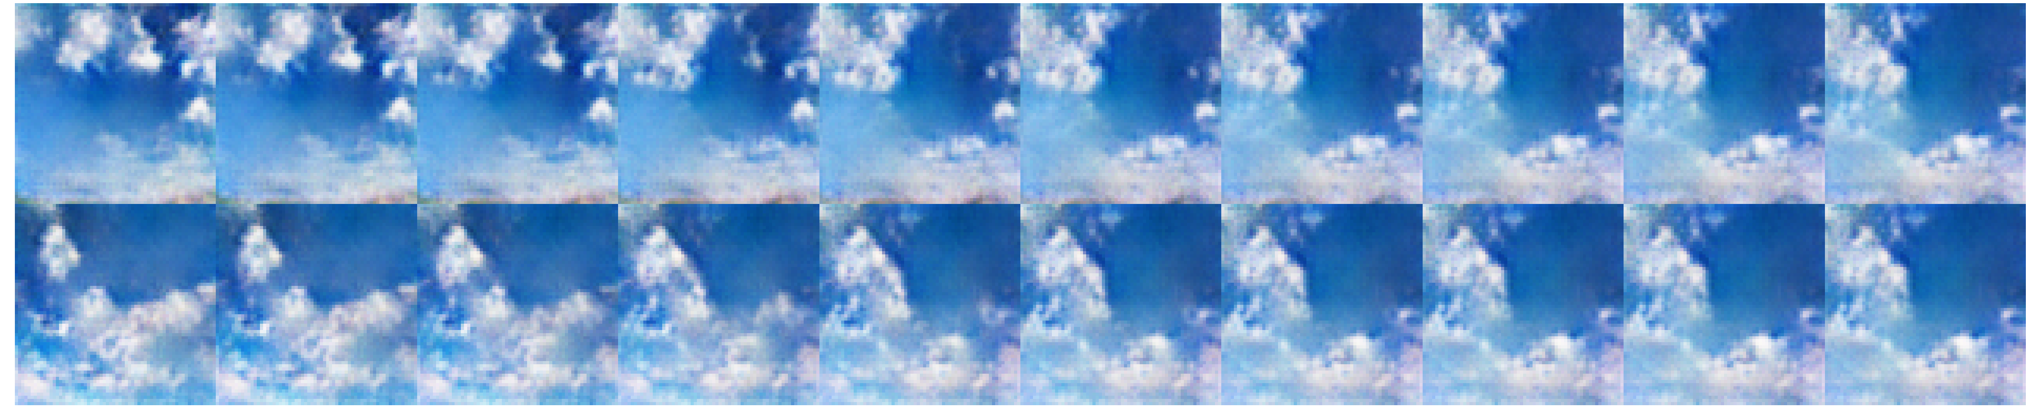
Walking in the Latent Space of SkyGAN
WGAN
DCGAN

Slide 16
Summary
Unsupervised Representation Learning of Weak Structured Images
DCGAN and WGAN
Implementation: build model using Pytorch, training in Nvidia-K80
Images crawling: Ma, Model code: Ma& Cheng, Experiments: Cheng, Result analysis &visualization: Ma

Slide 17
Thank You!

